Slide 1

Oracle Identity Governance and SailPoint IIQ
IDAM Holiday Readiness 2023​

Slide 2
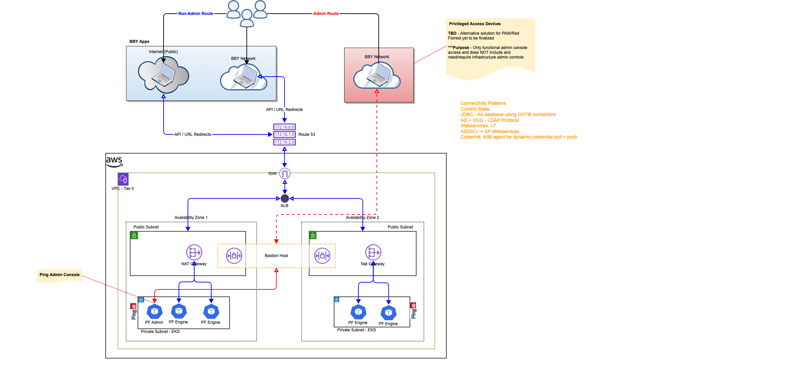
Access Patterns - SailPoint

Slide 3
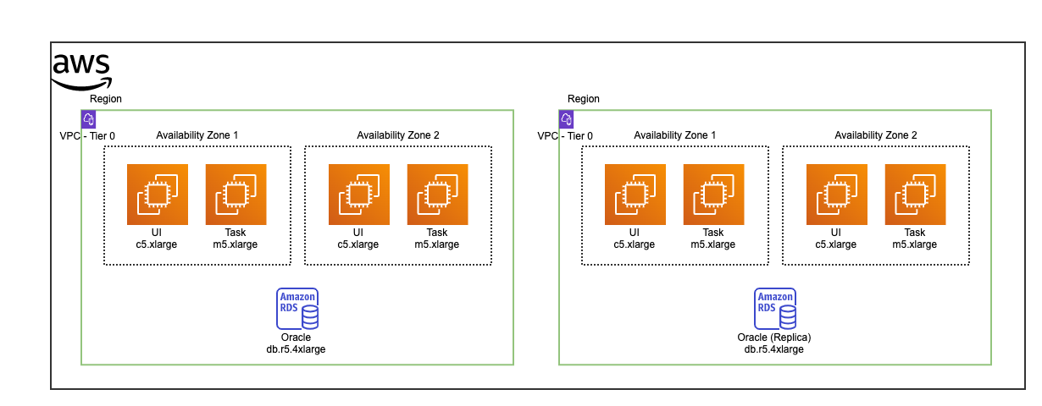
Physical Architecture - SailPoint: Vendor

Slide 4
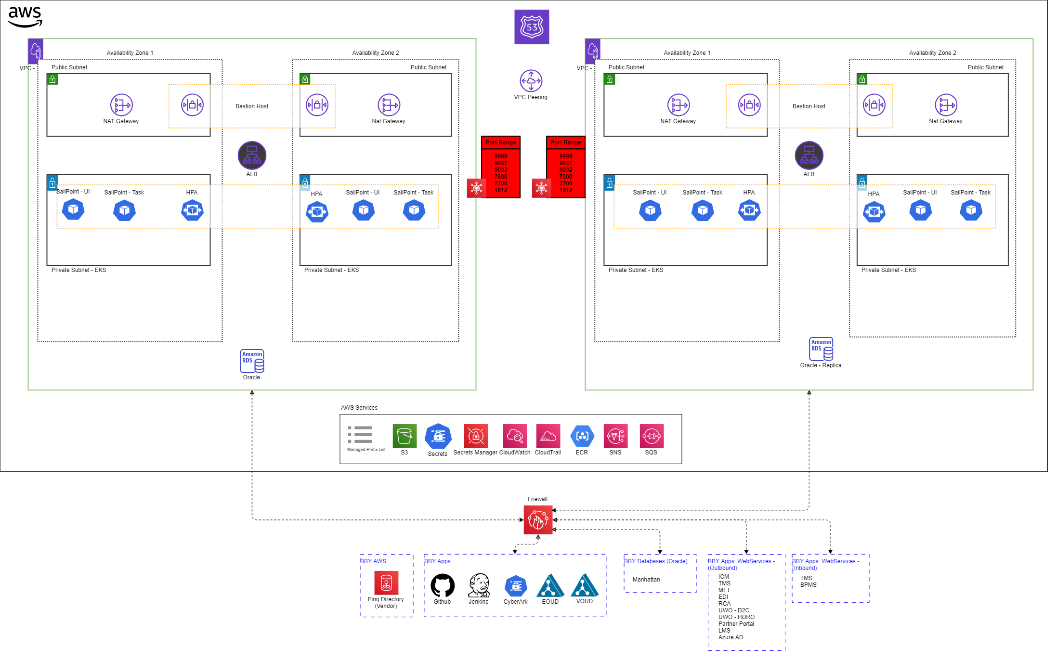
Logical Architecture - SailPoint: Vendor

